Slide 1
QC metric Single cell multiom
Miren Lasaga
25/11/2021

Slide 2
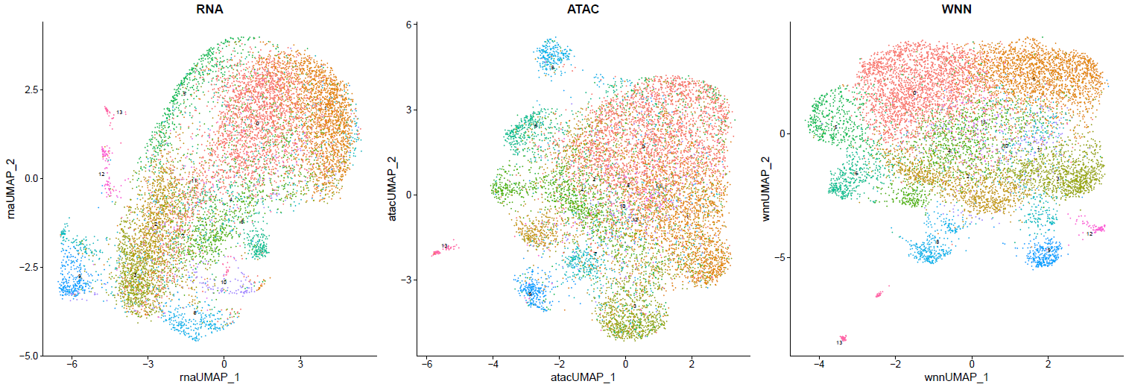
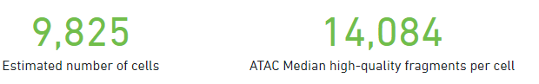
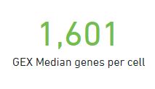
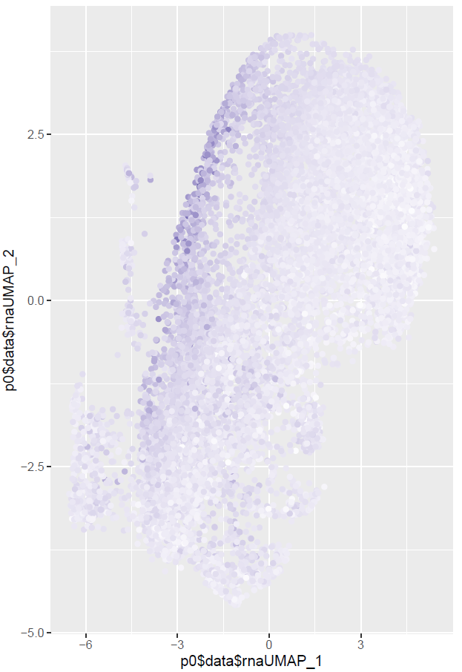
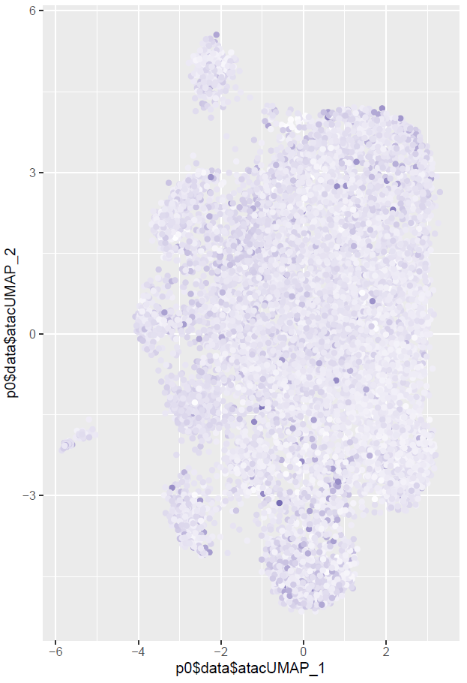
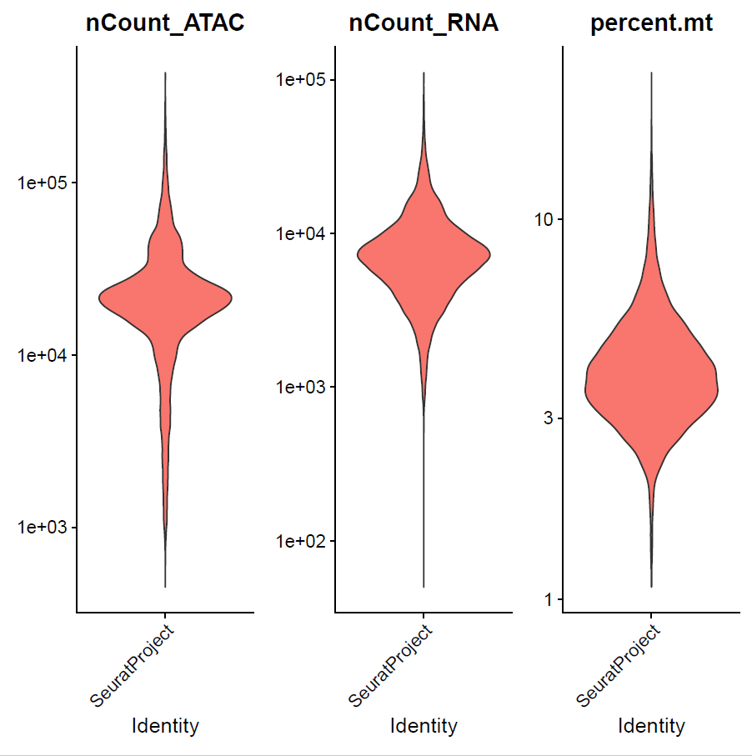
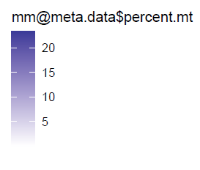
Fresh sample

Slide 3
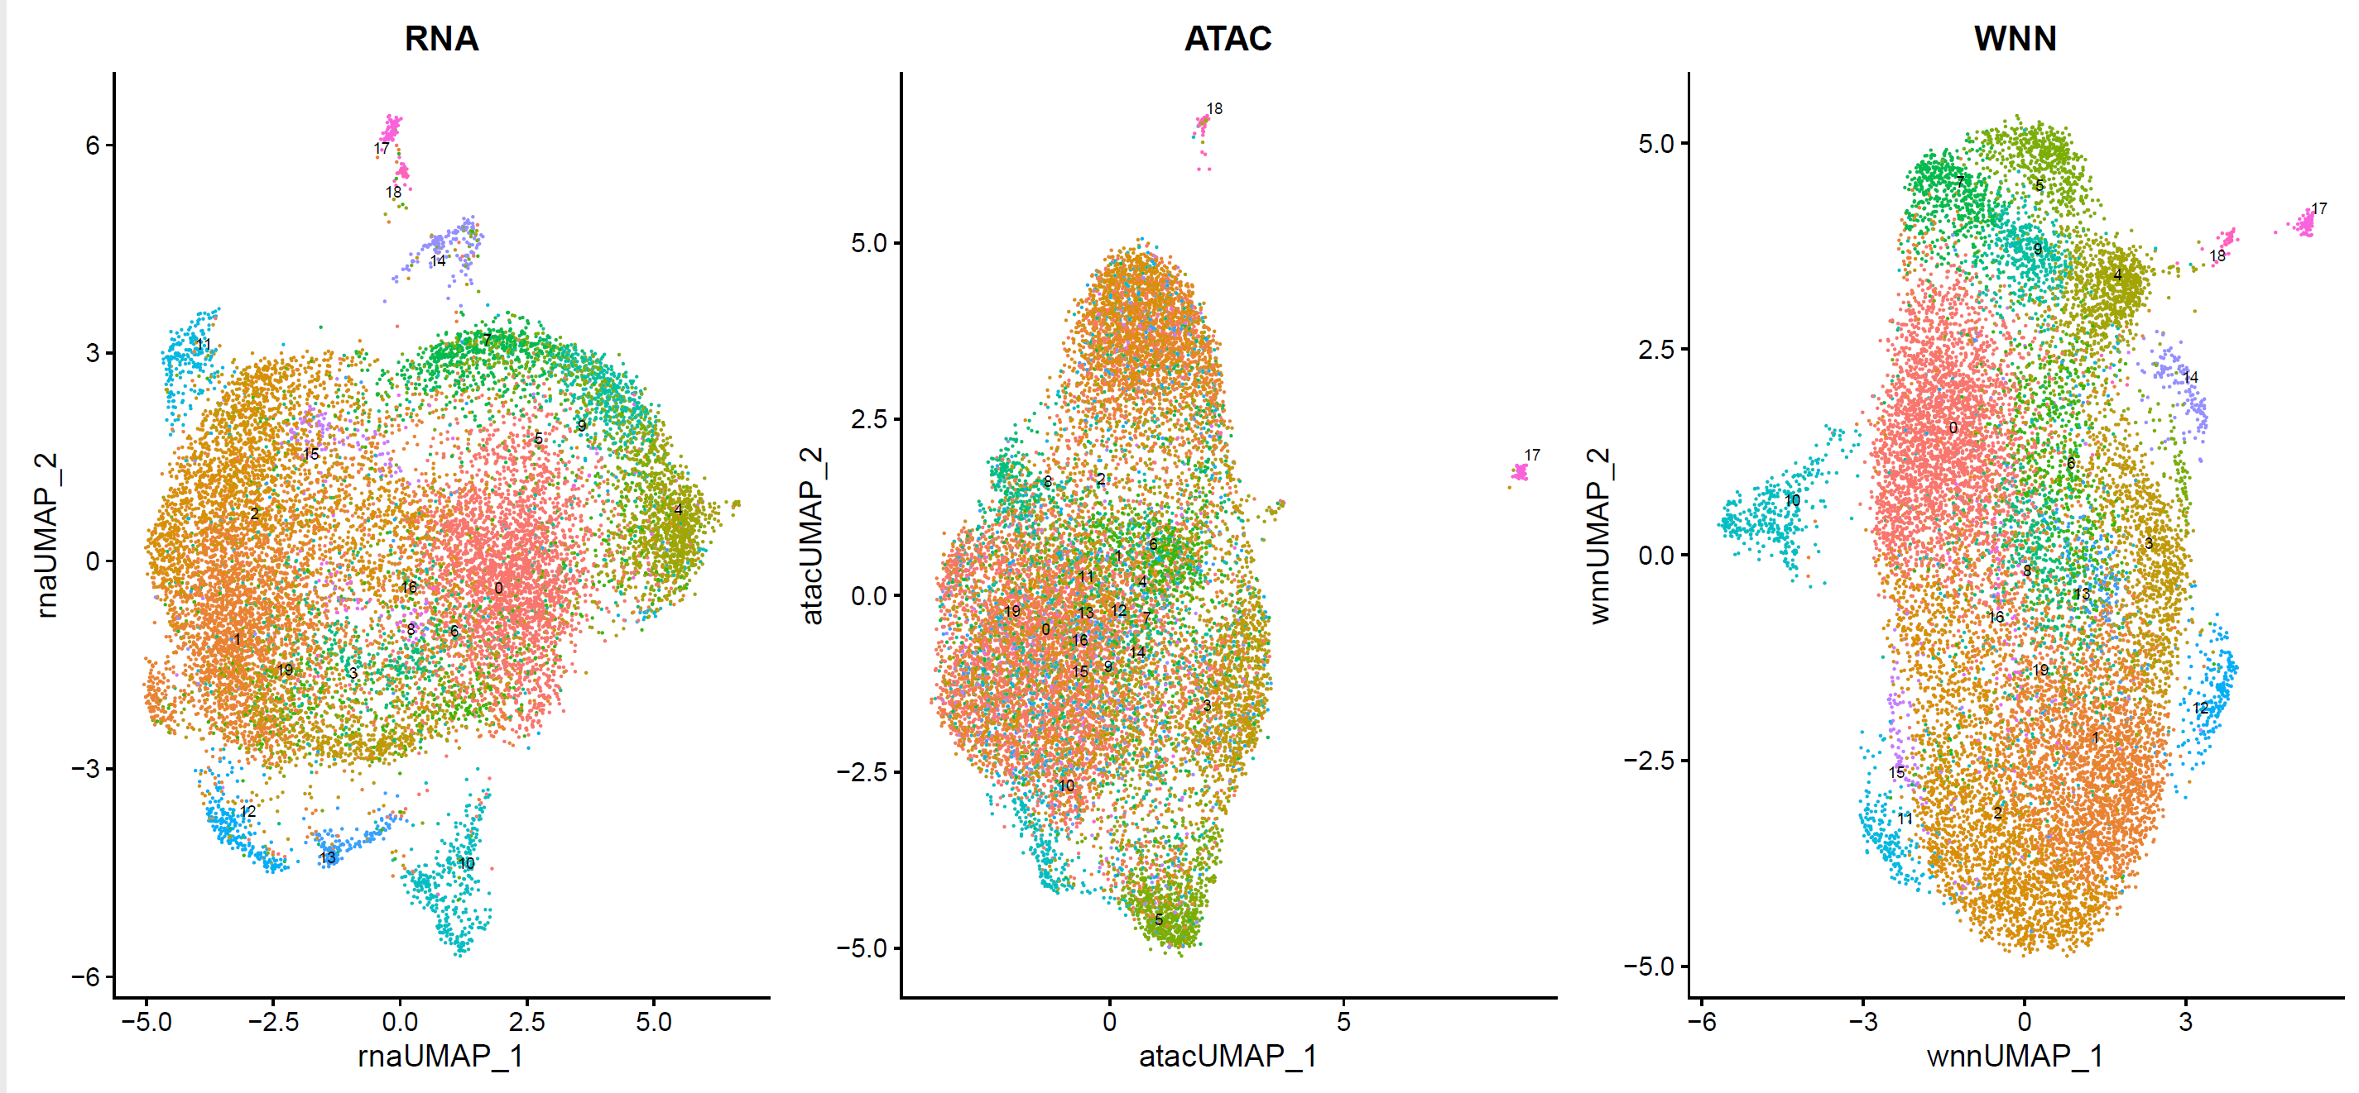
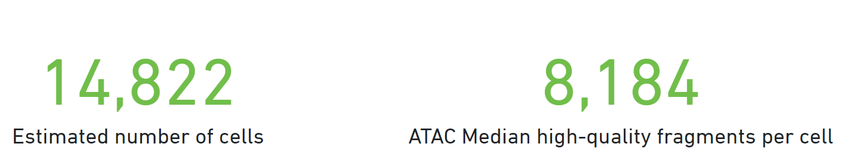
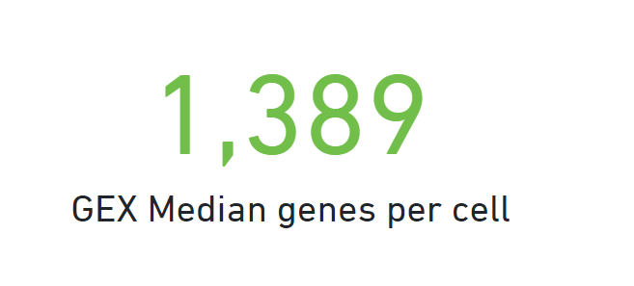
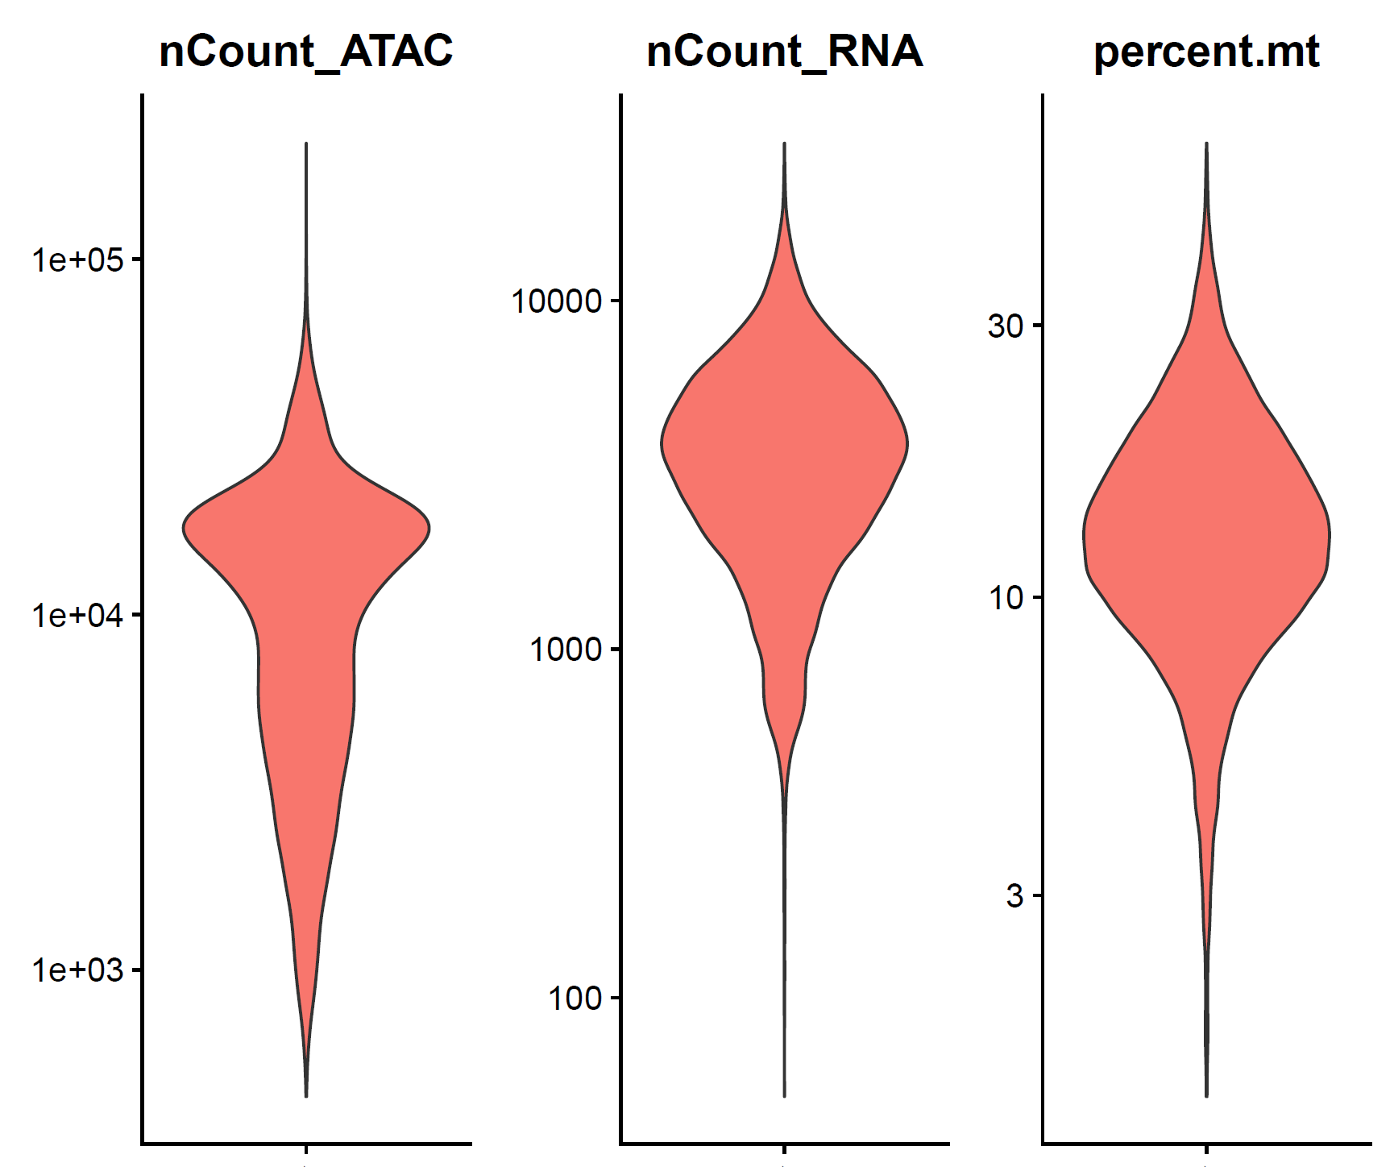
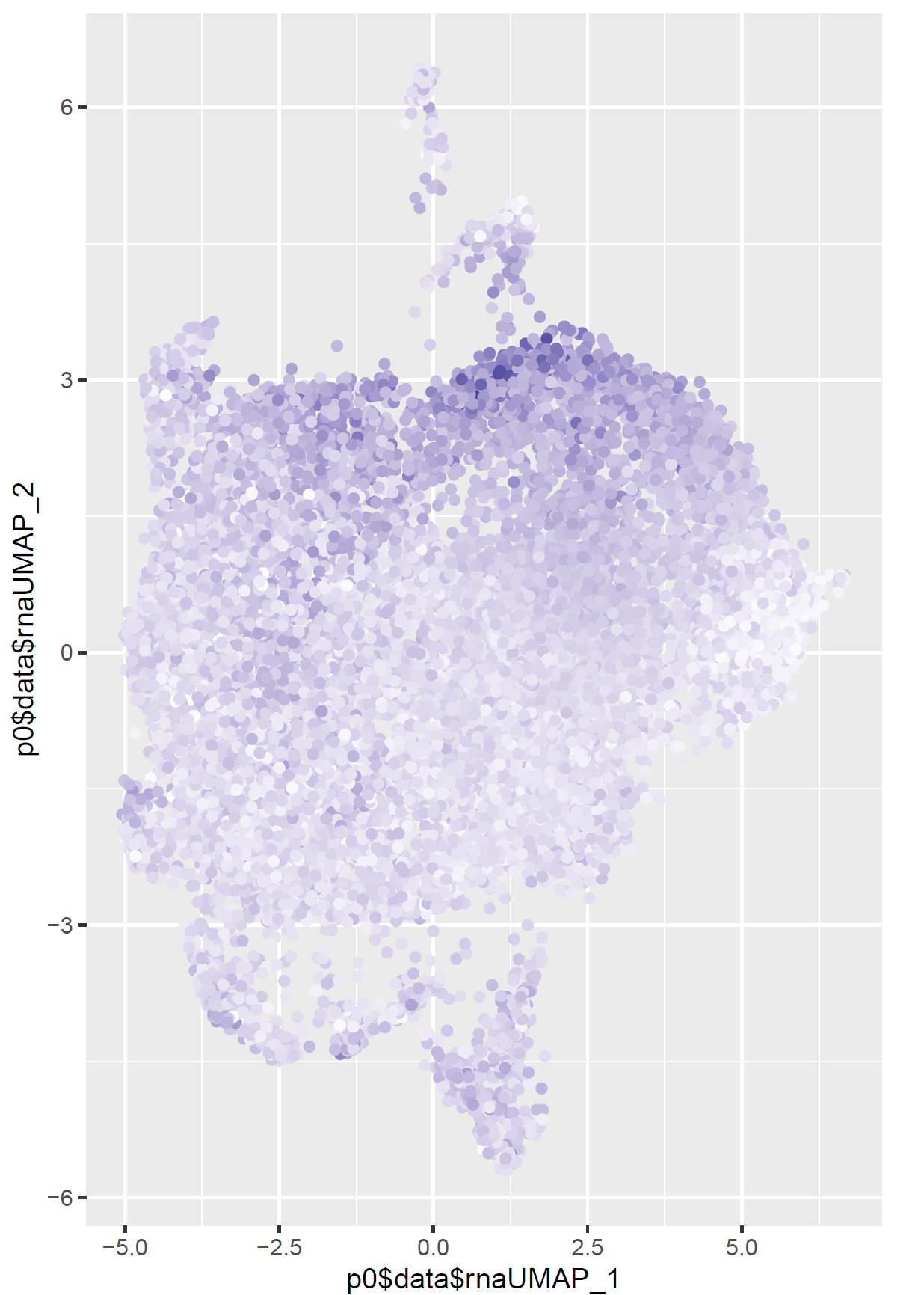
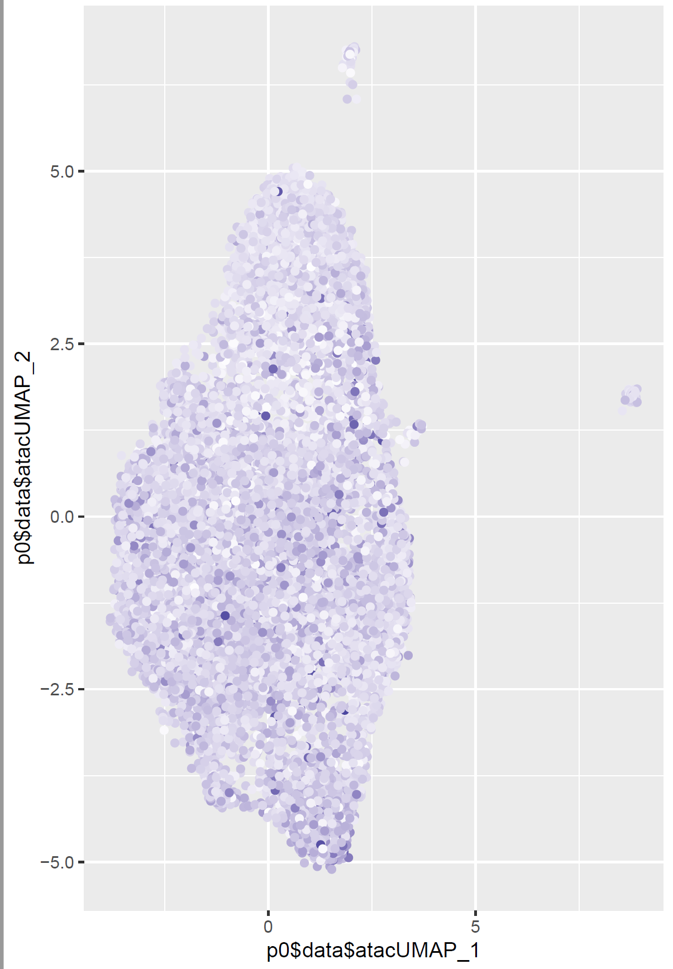
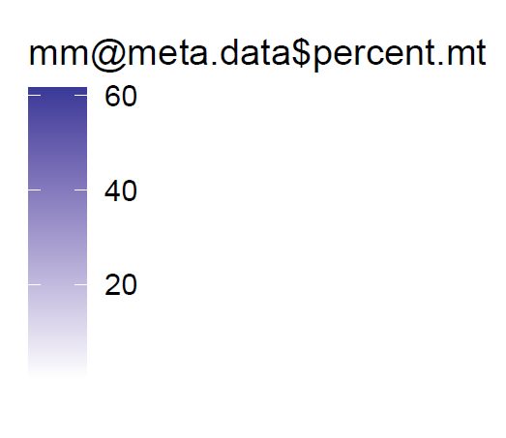
MM_no_HR_937961
Mt %

Slide 4
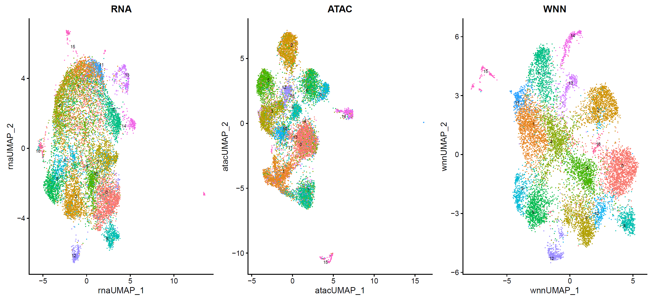
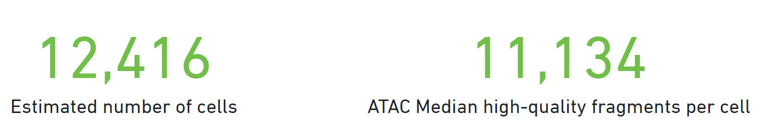
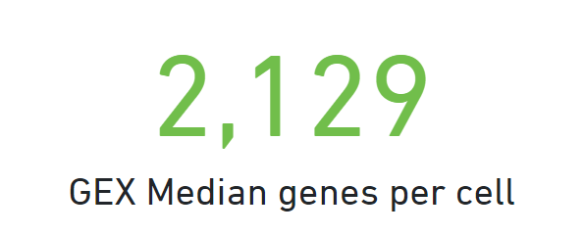
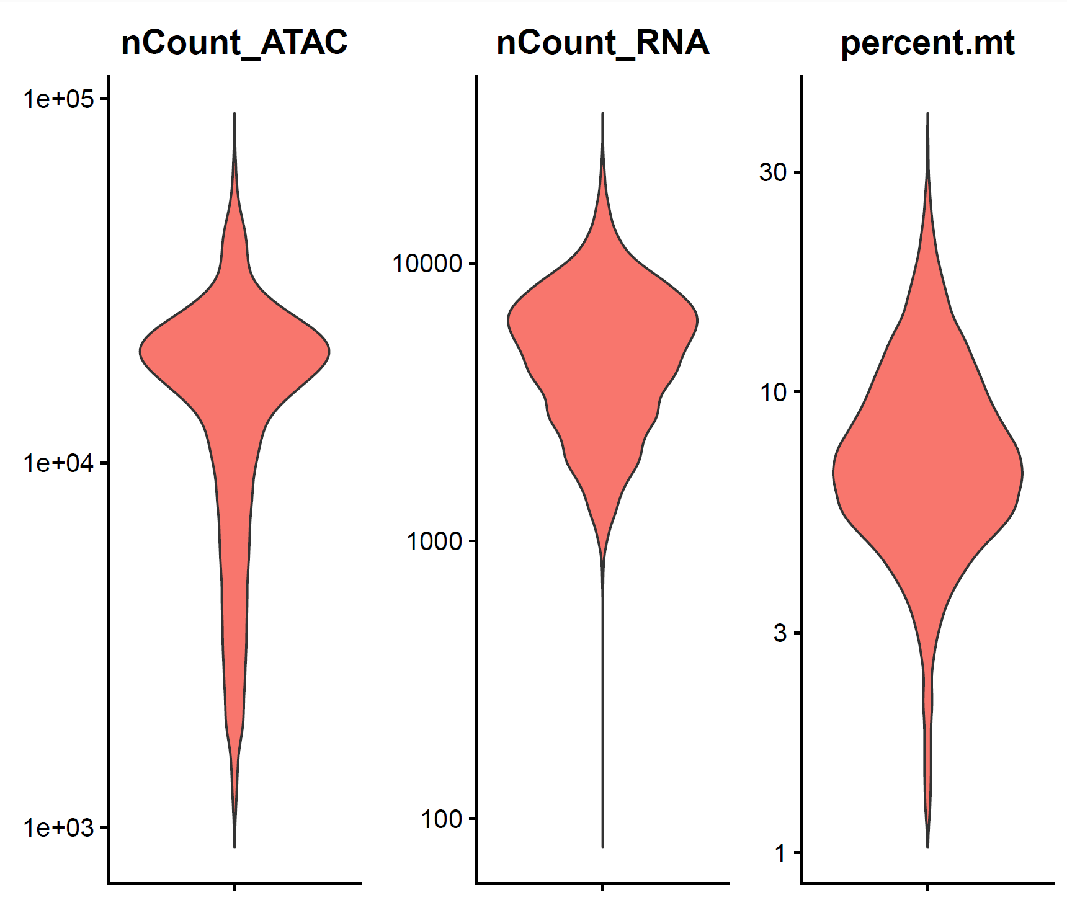
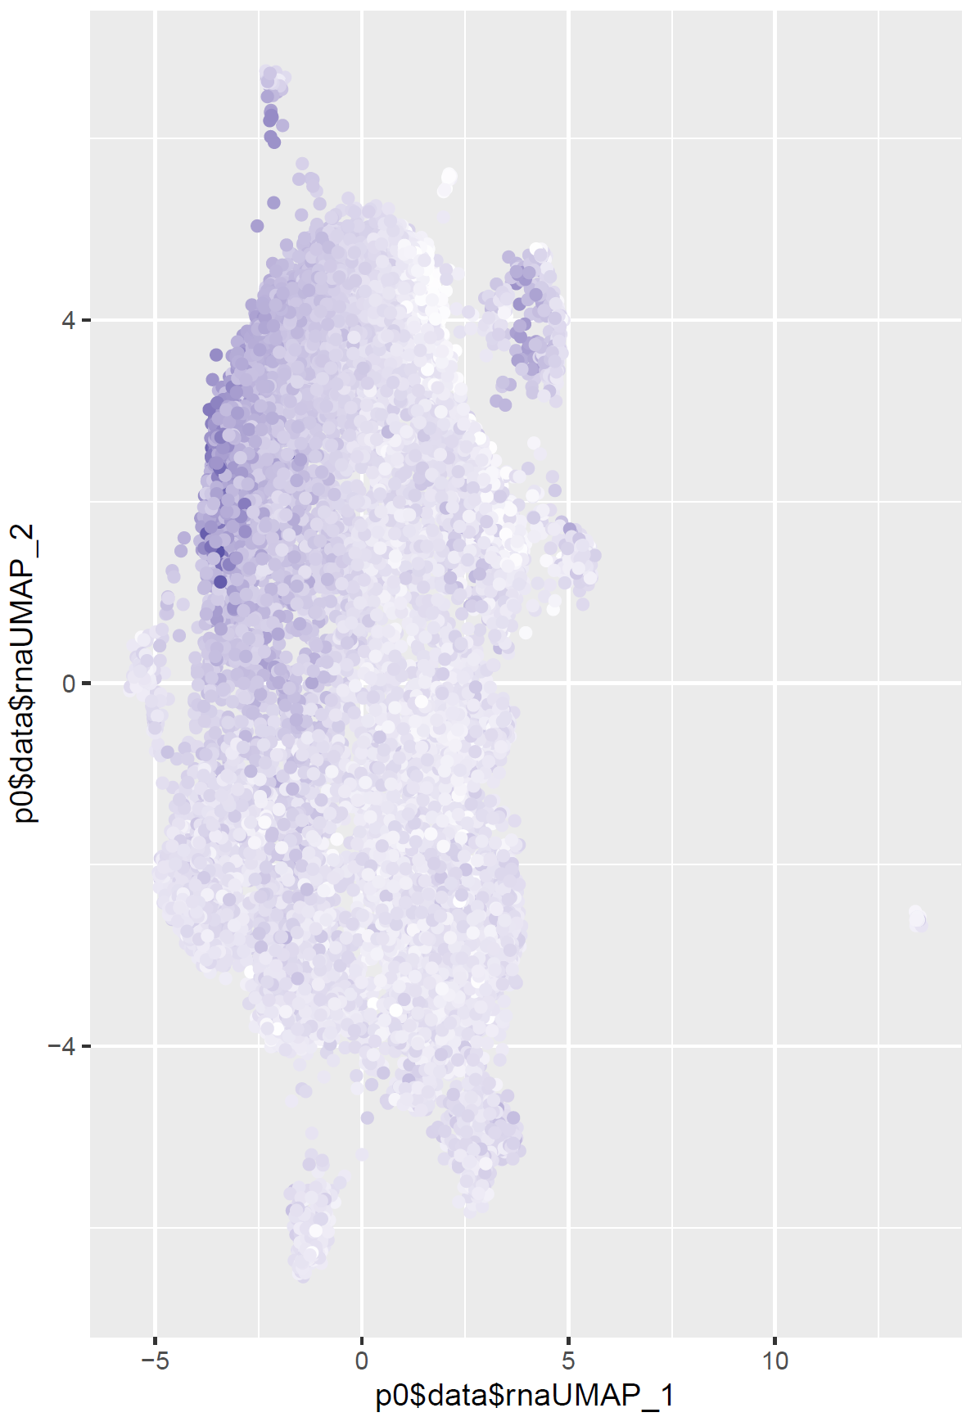
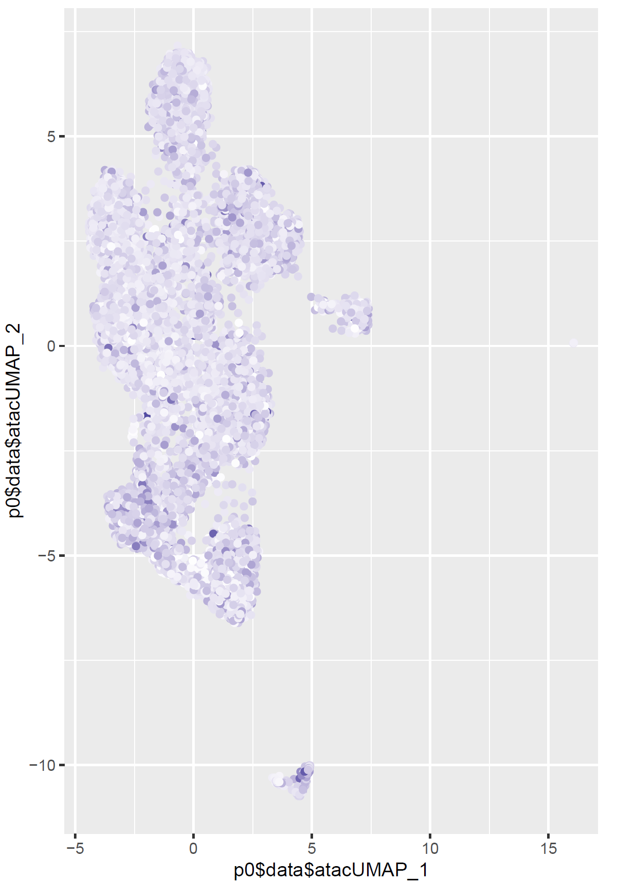
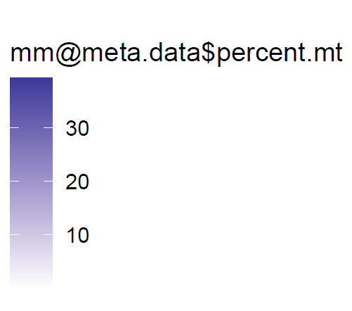
MM_HR_9070520
Mt %

Slide 5
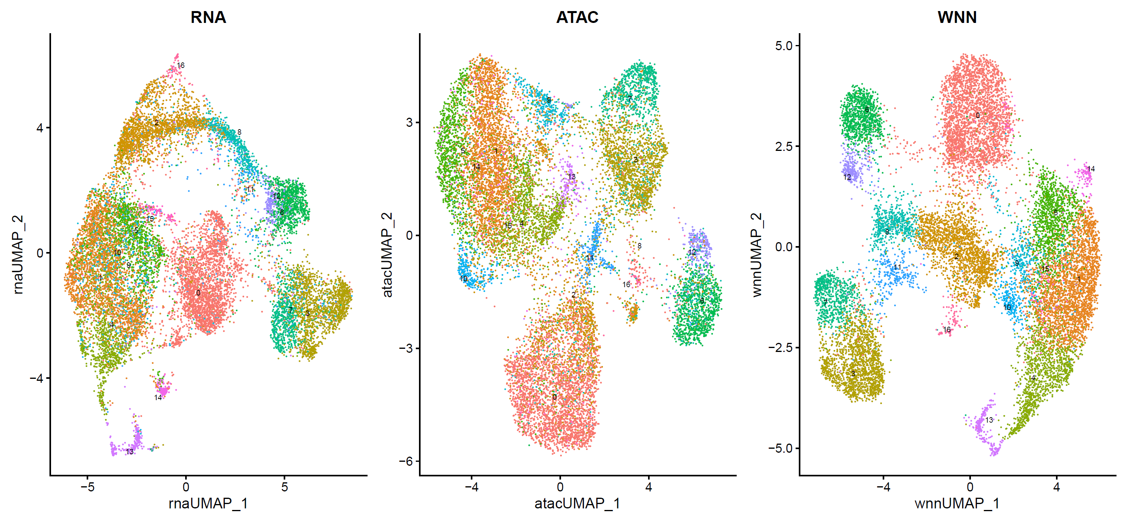
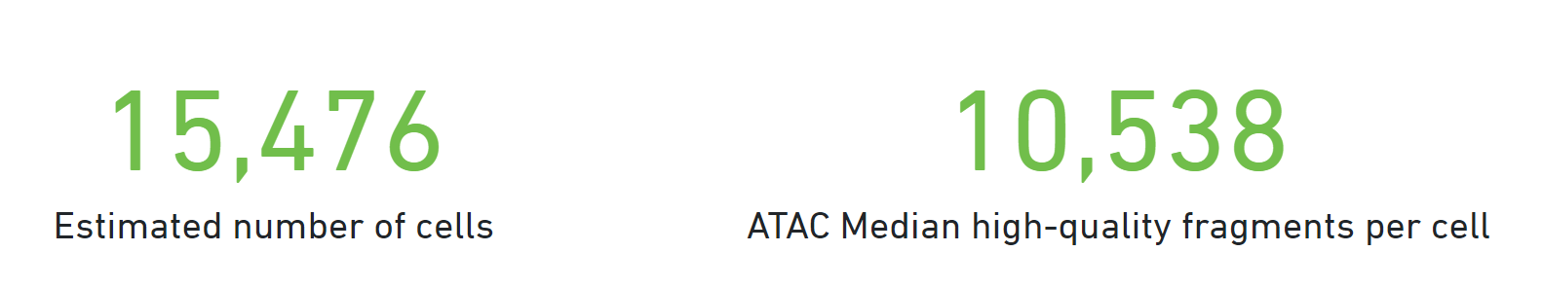
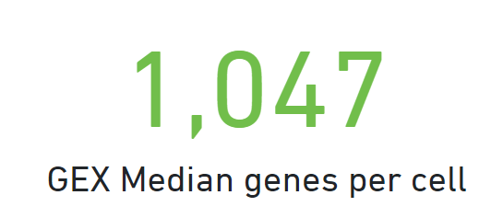
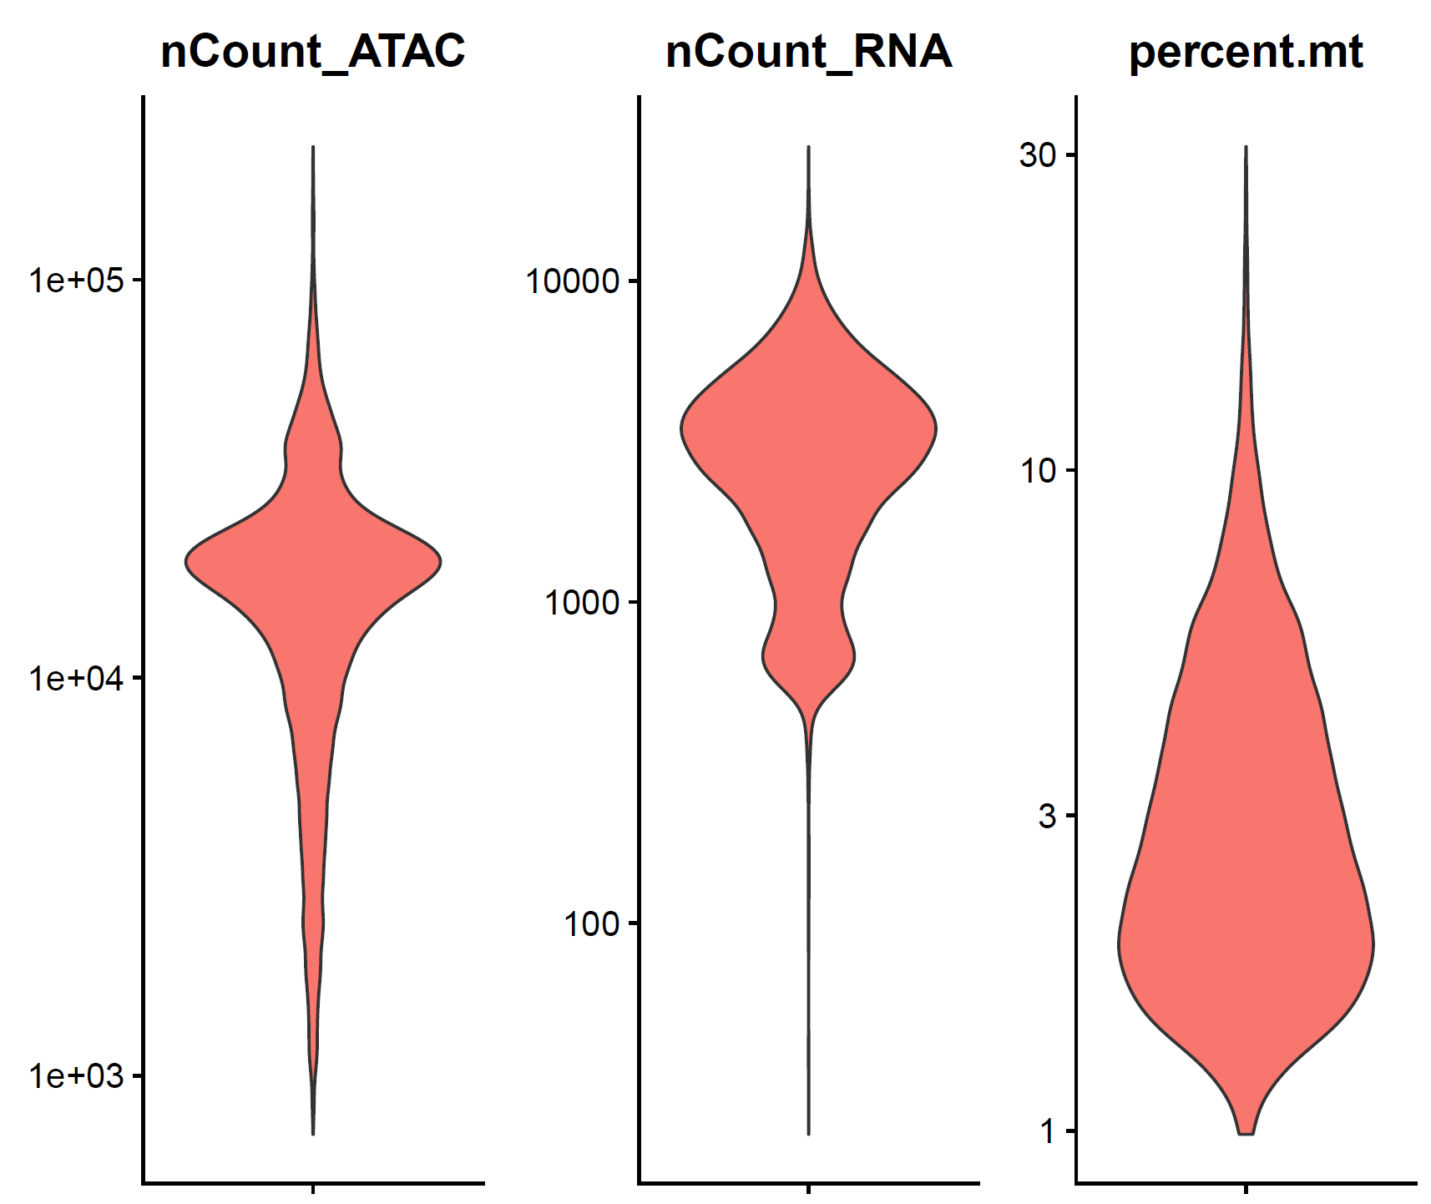
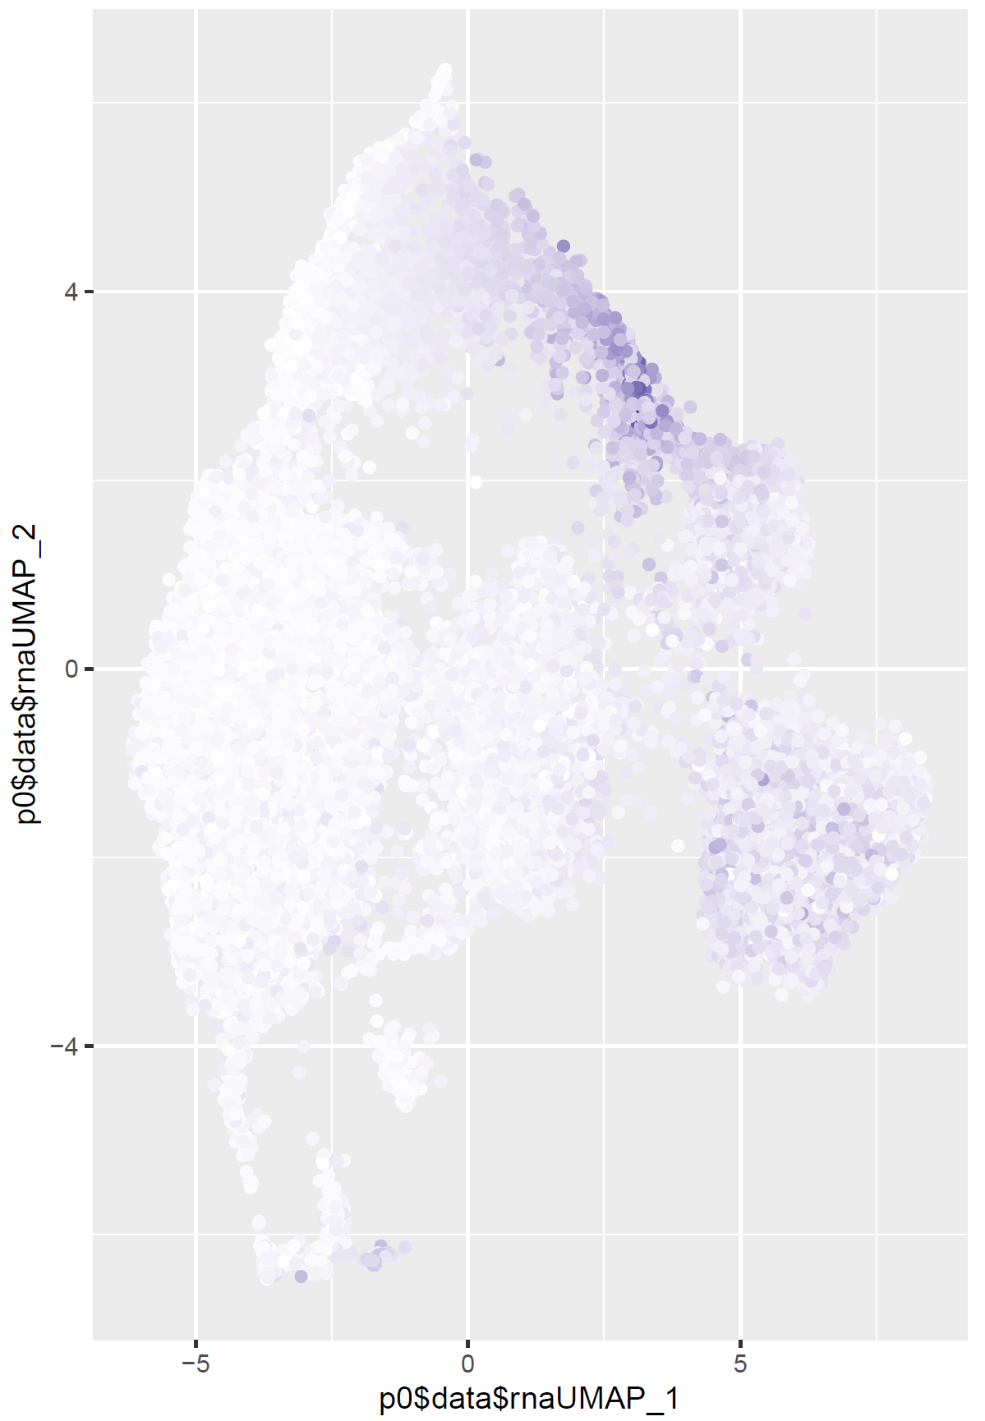
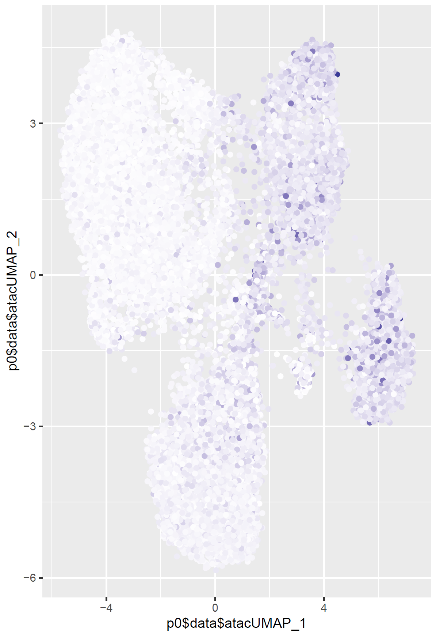
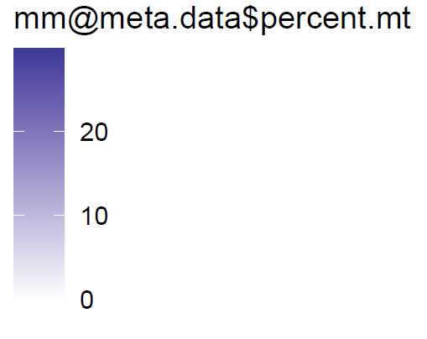
MM_HR_295303
Mt %

Slide 6
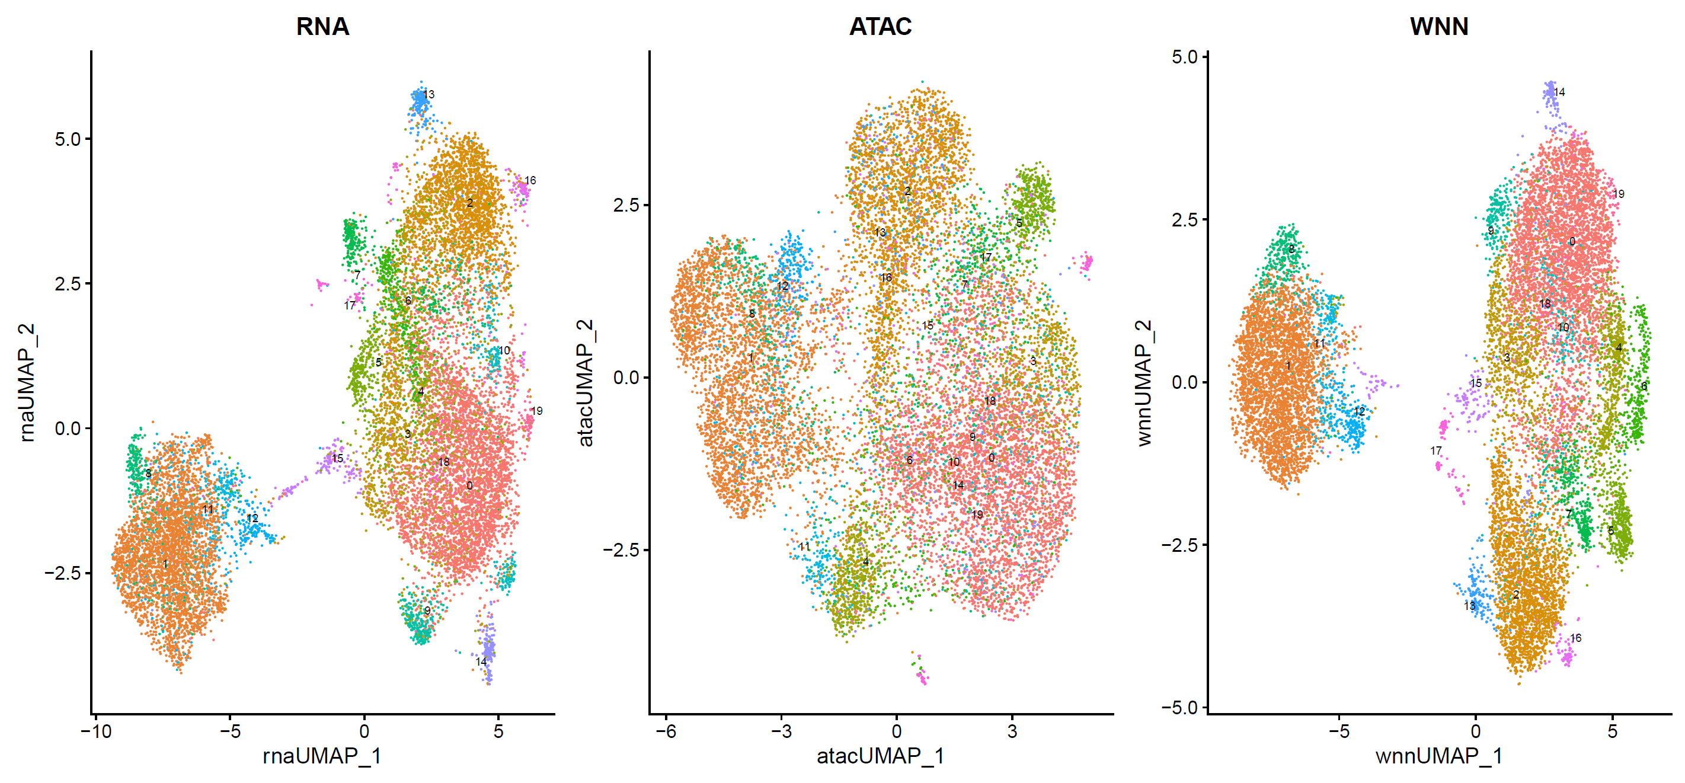
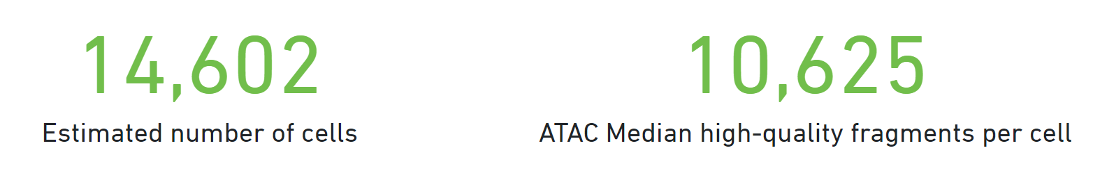
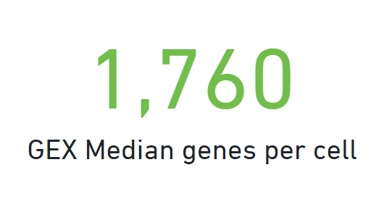
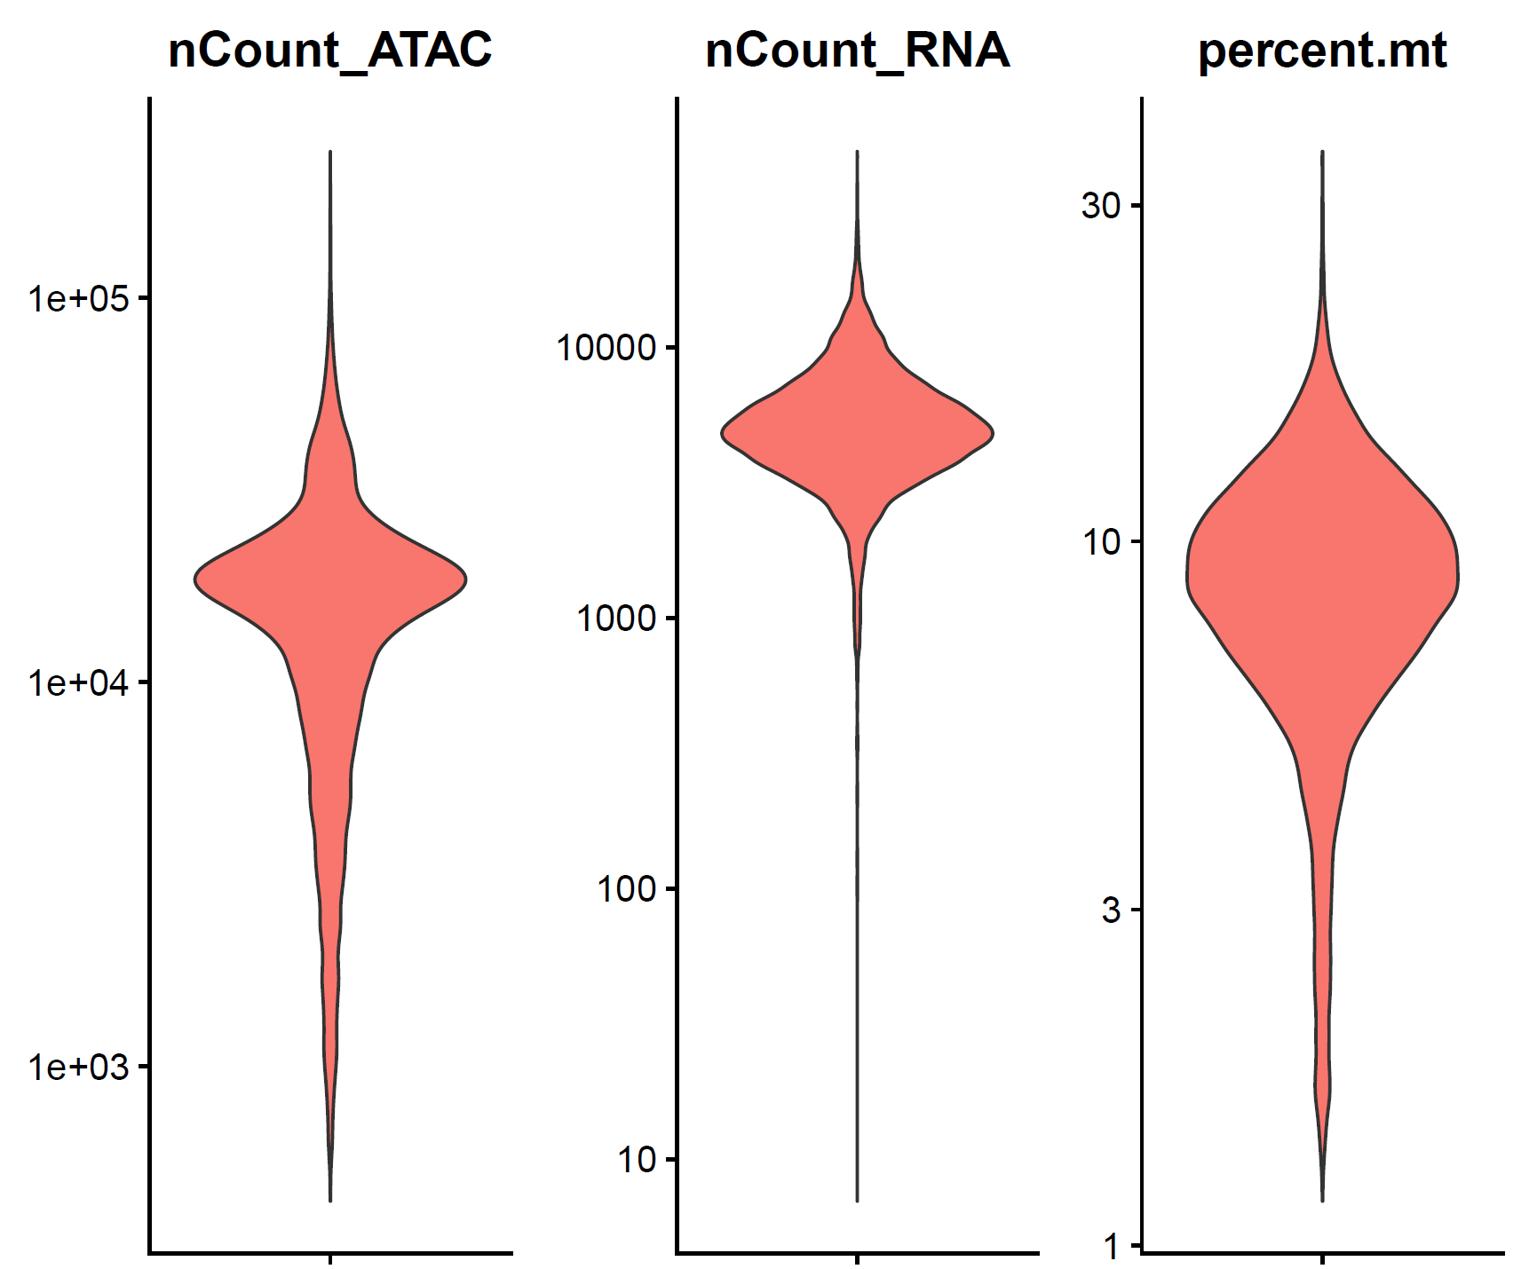
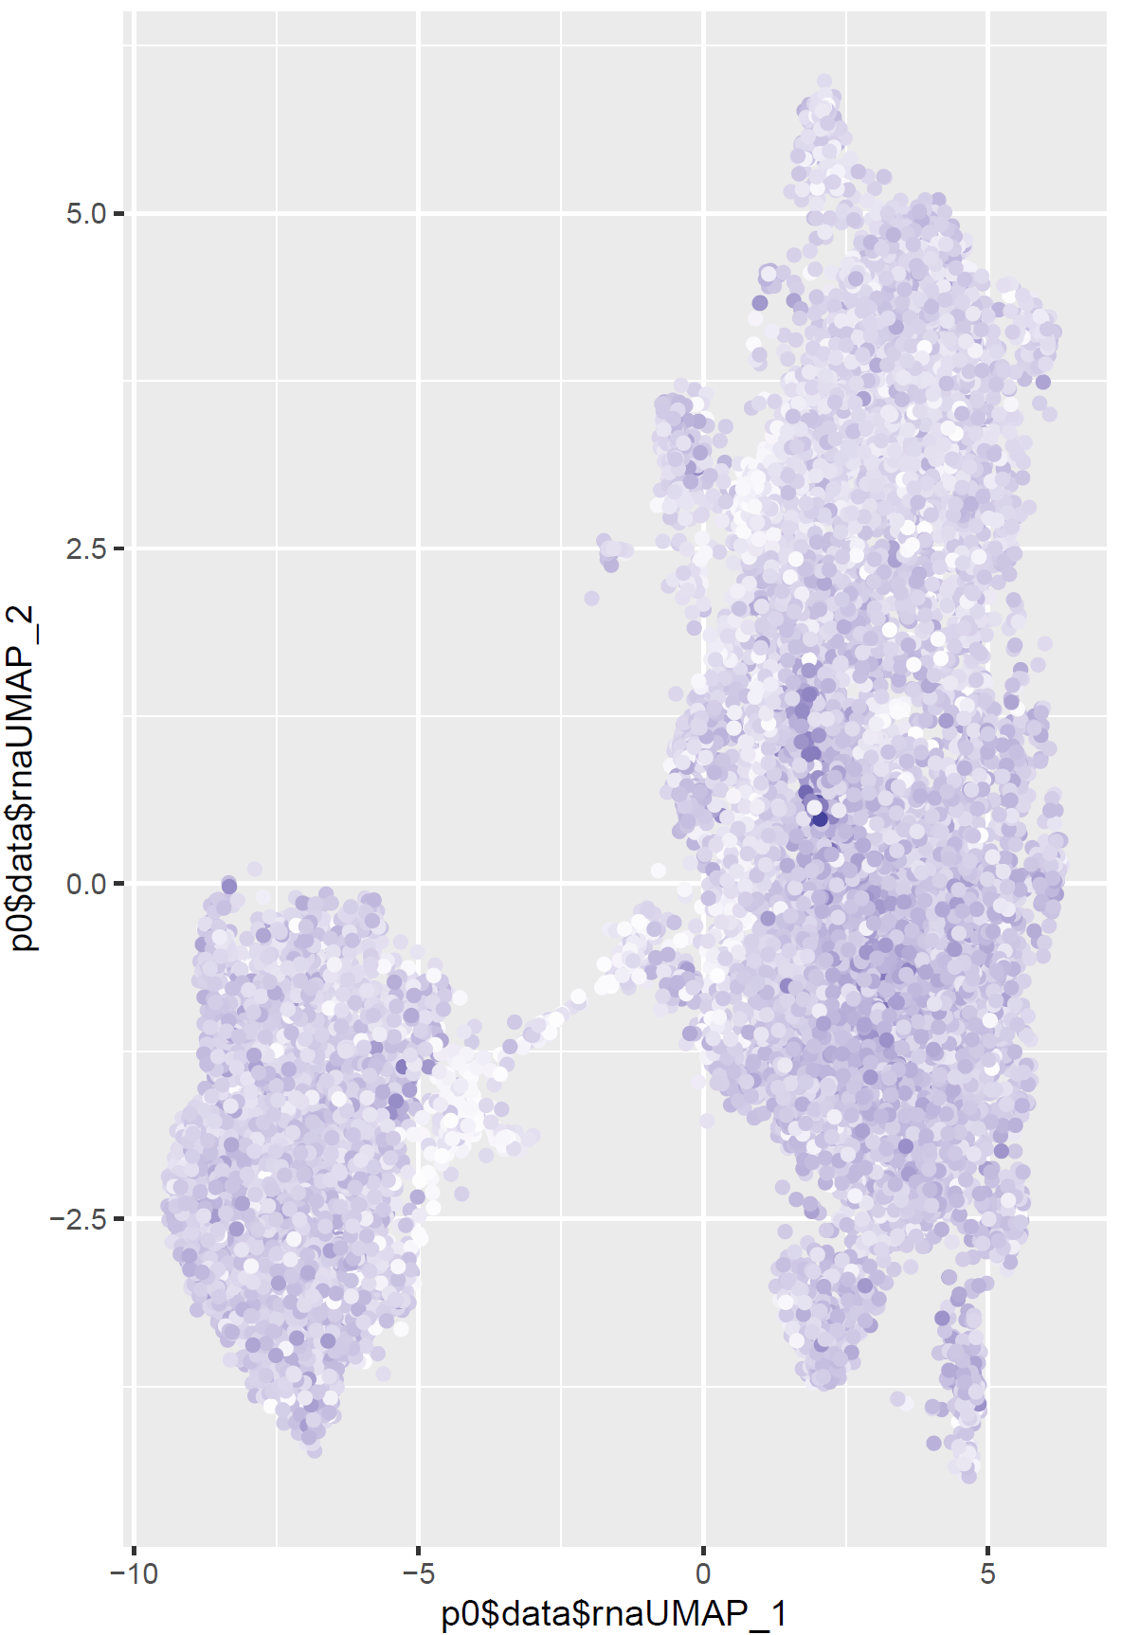
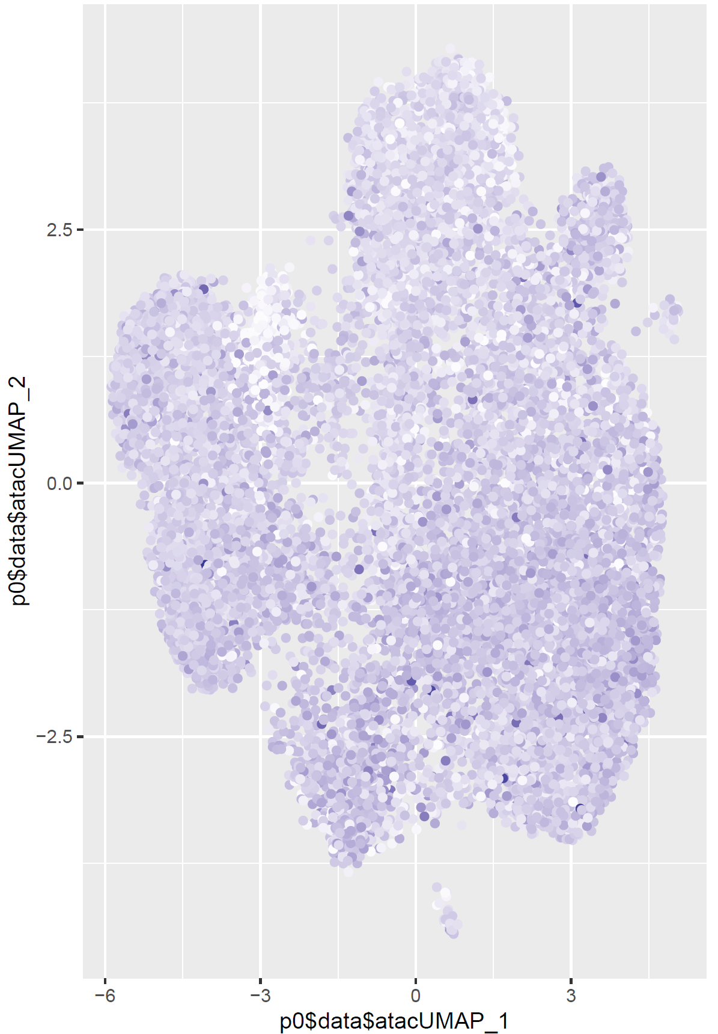
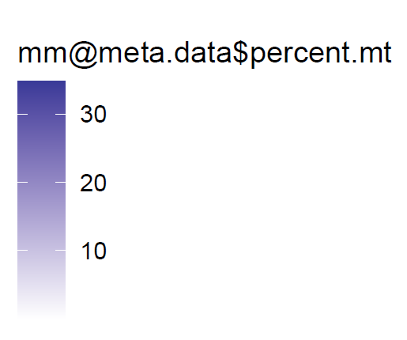
Smouldering_937961
Mt %

Slide 7
Multiom
percentage=nFeature/nCounts
Cells with low counts but high number of genes

Slide 8
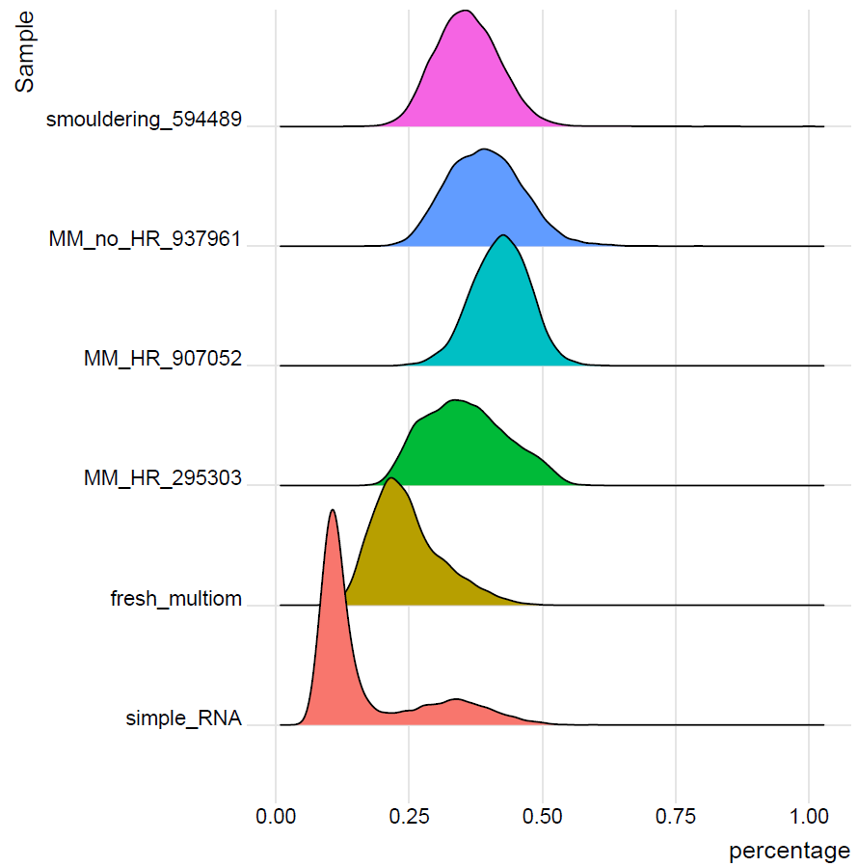
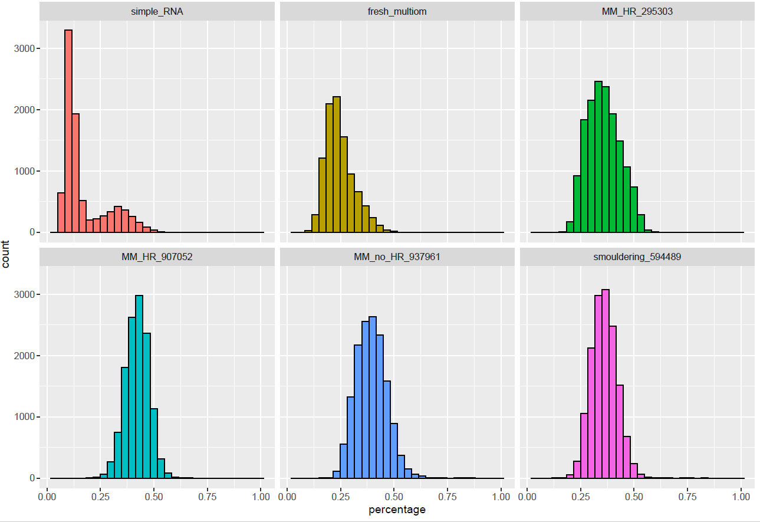
Including single RNA
percentage=nFeature/nCounts

Slide 9
Multiom
percentage=nFeature/nCounts

Slide 10
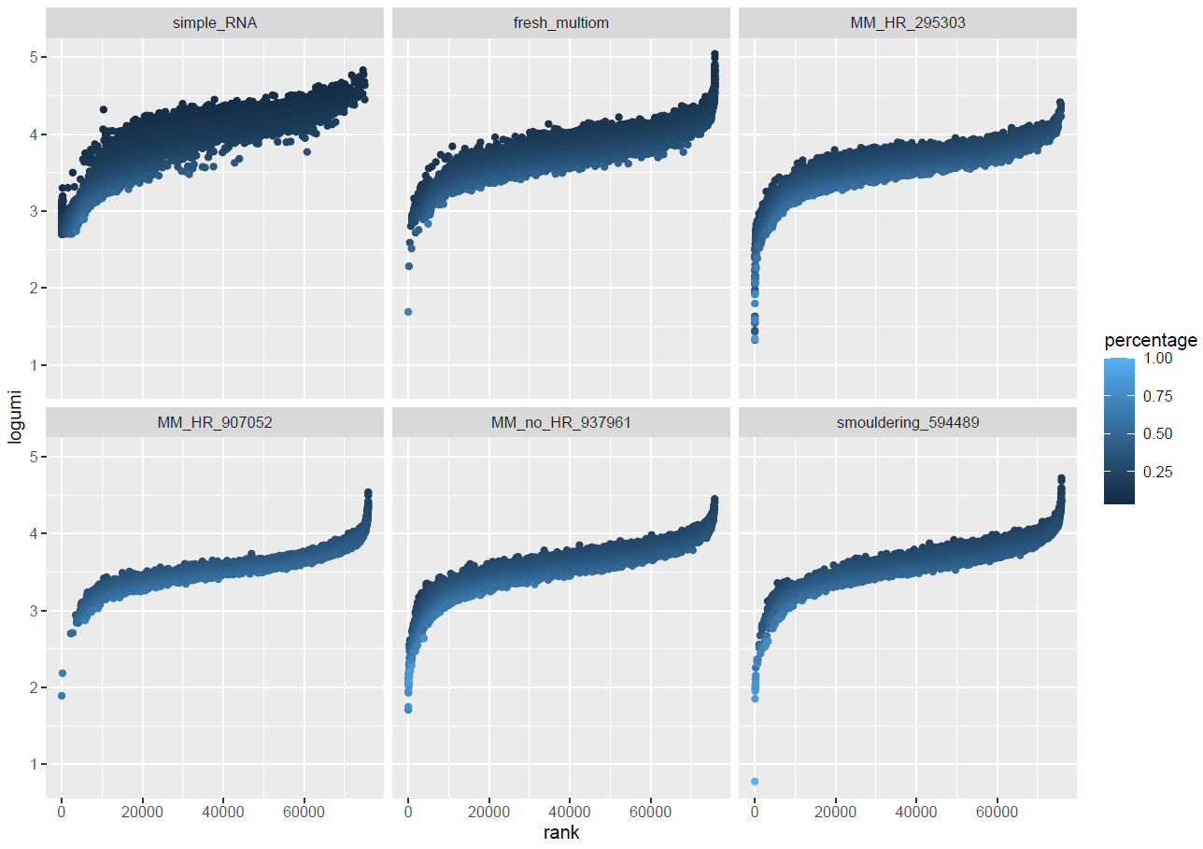
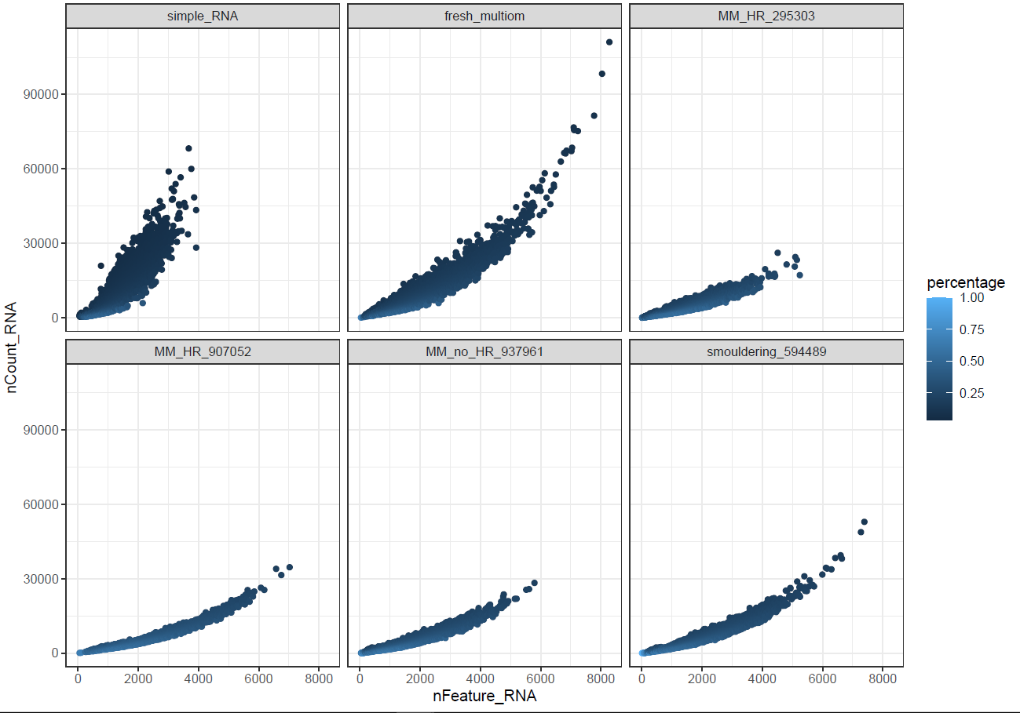
Including single RNA
percentage=nFeature/nCounts

Slide 13
Gene_peak_ratio=genes/peaks

Slide 14
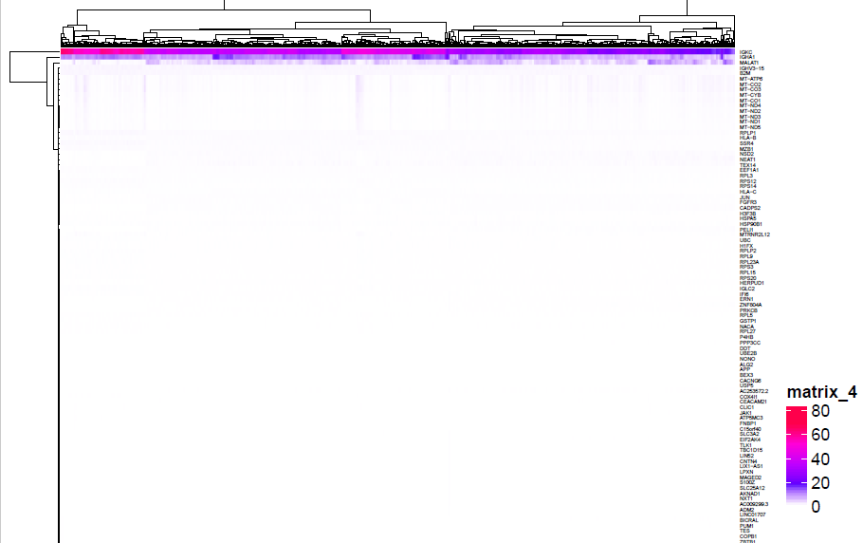
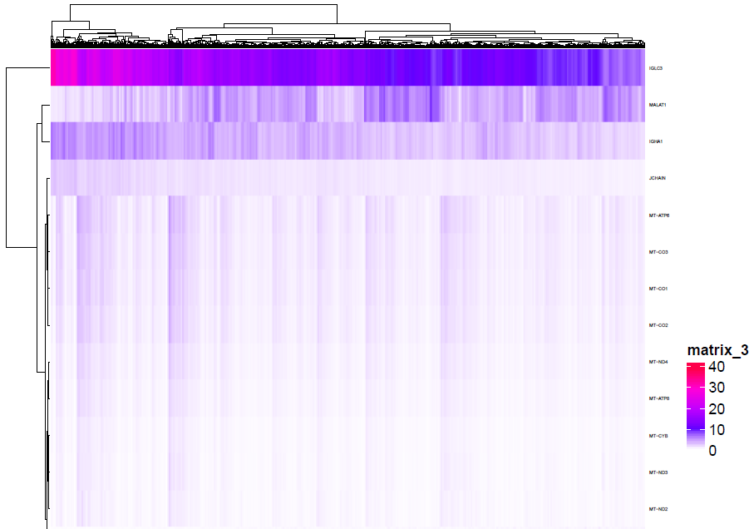
MM_HR_295303
MM_HR_907052

Slide 15
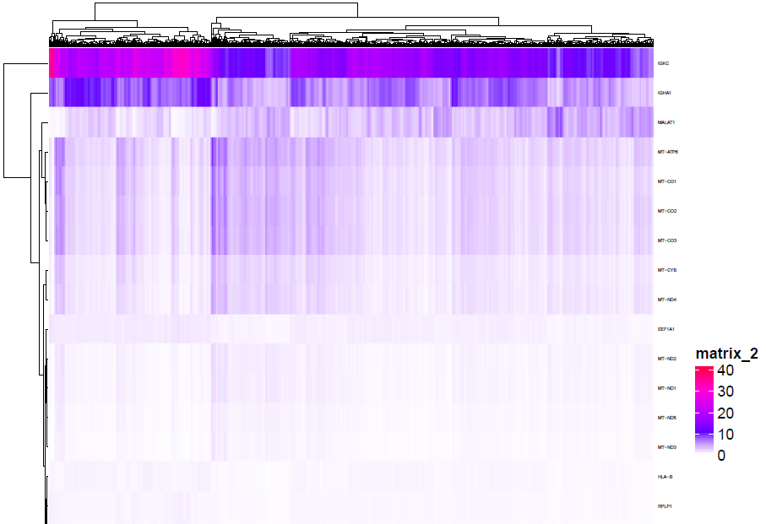
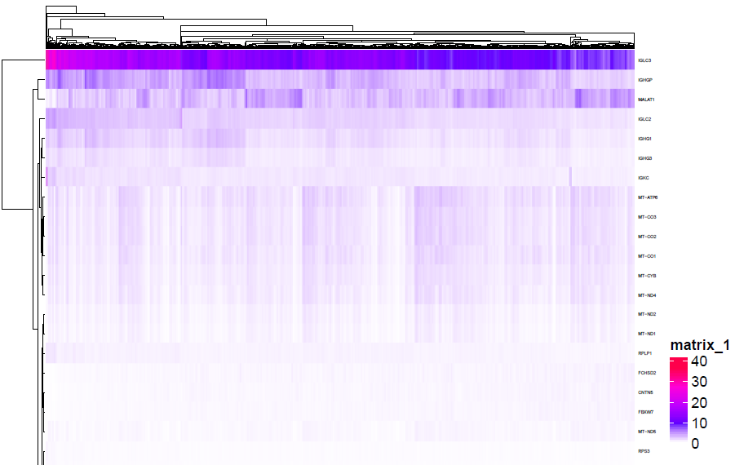
MM_no_HR_937961
smouldering_594489

Slide 16
Fresh sample

Slide 17
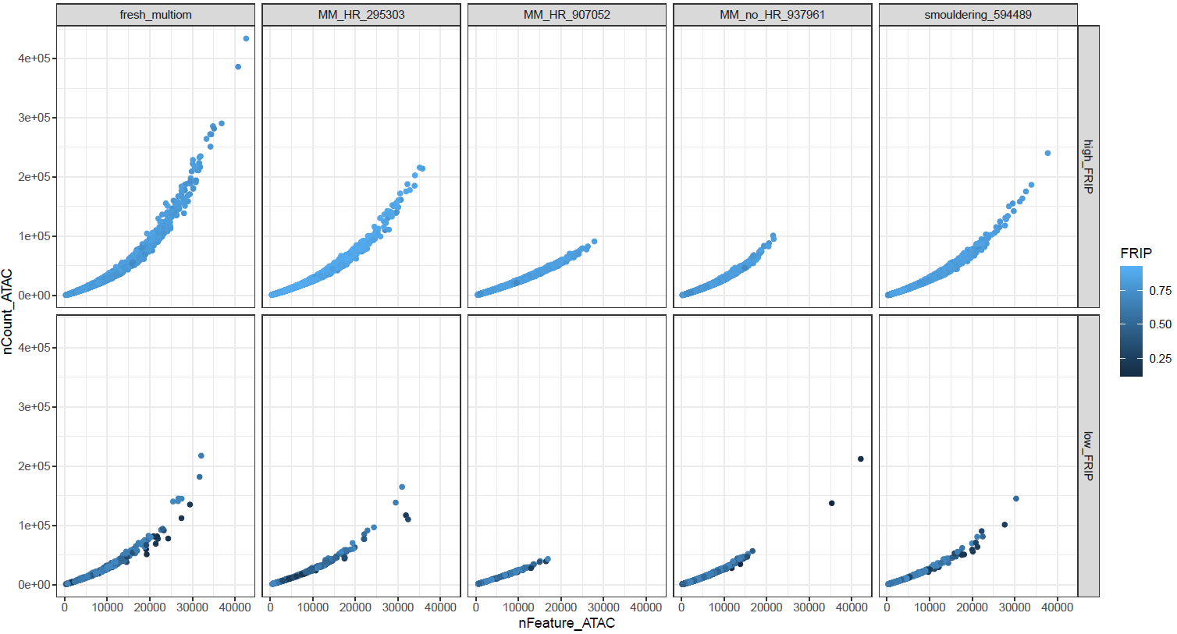
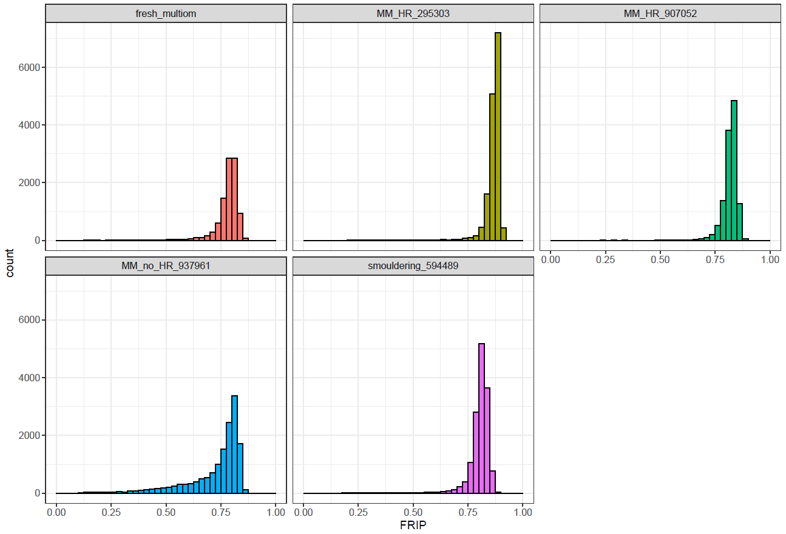
ATAC

Slide 18
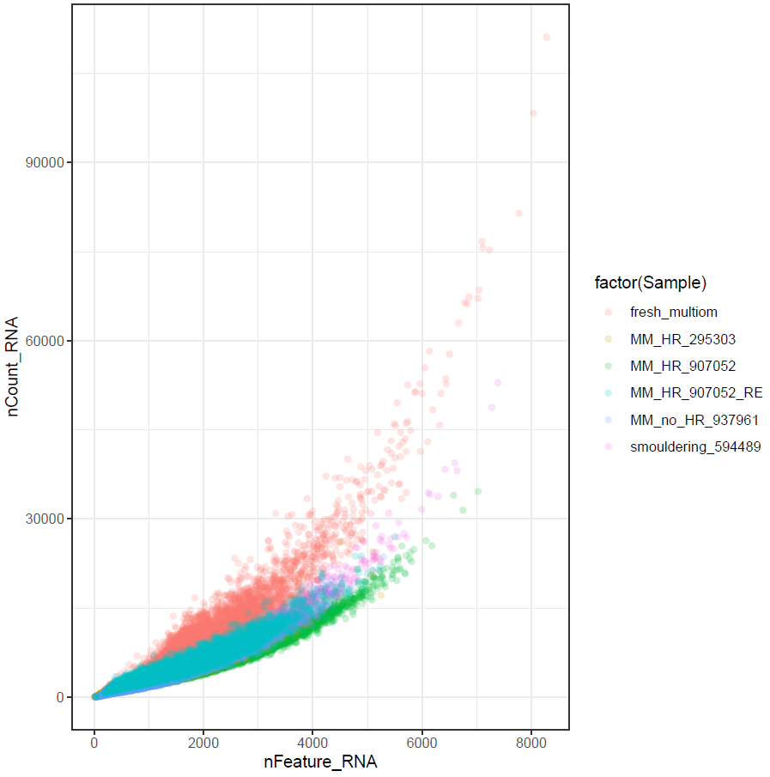
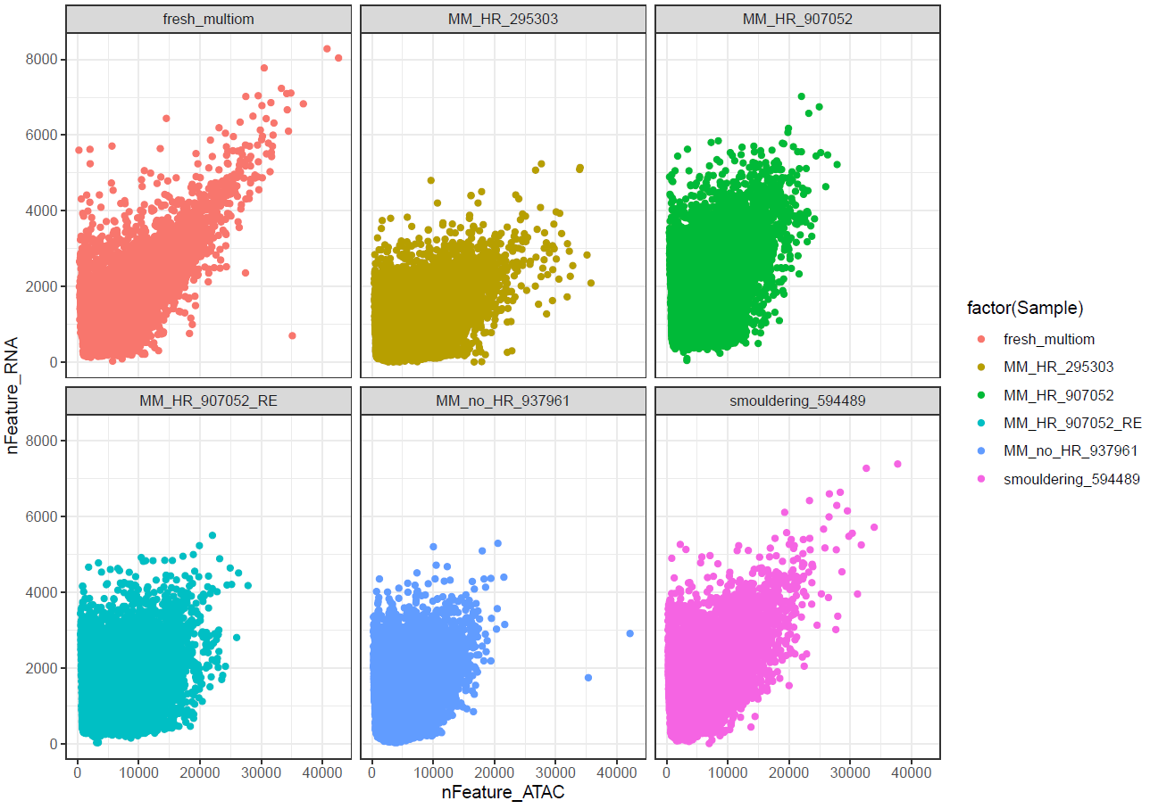
RE

Slide 19
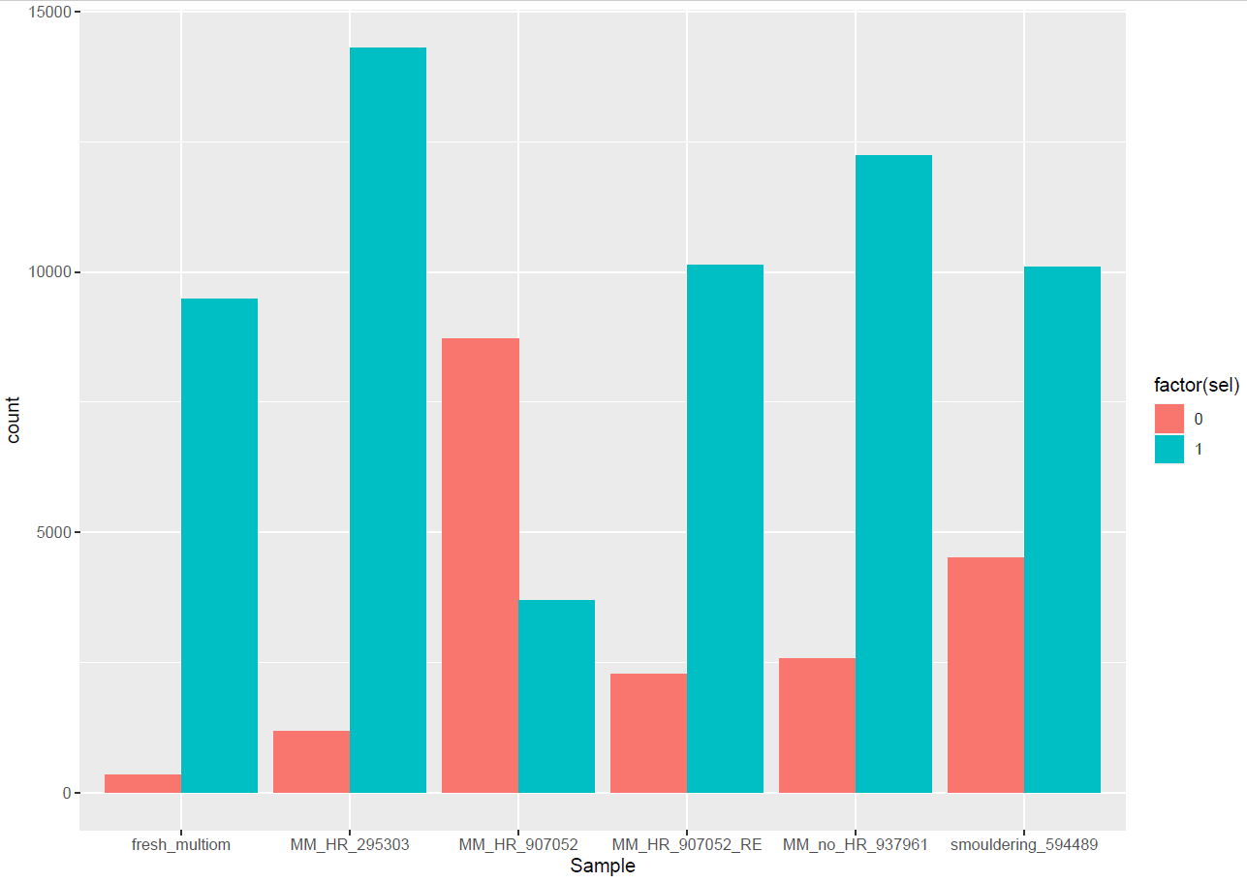
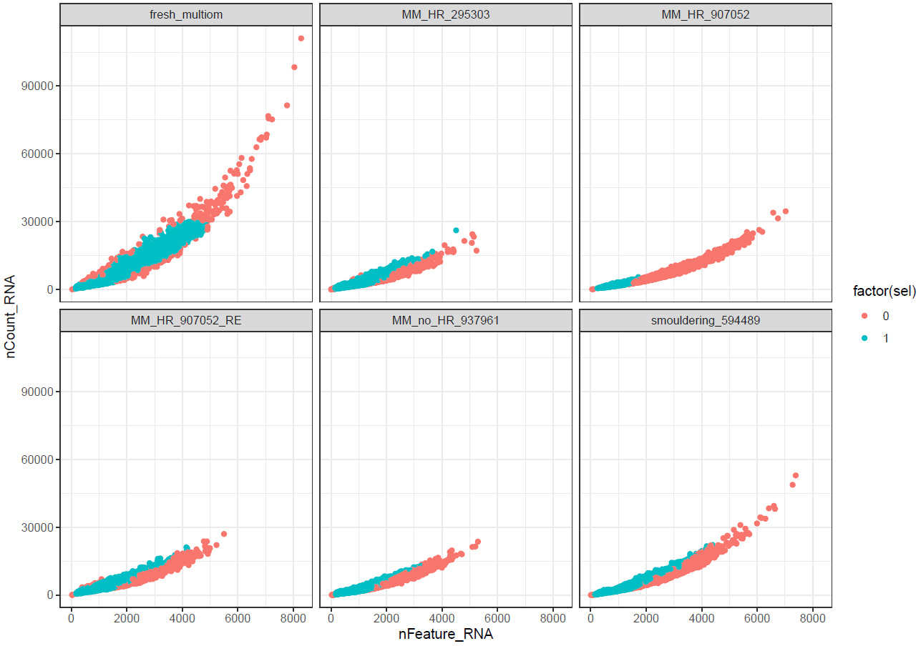
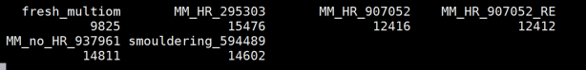

RE
nCount range: 0-100
ALL
After filtering

Slide 20


After filtering

Slide 21




After filtering

Slide 22

After filtering

Slide 23
Filtering criteria:
Counts
Features
Mt %
FRIP
Selection based on fresh sample

Slide 24




MM_HR_295303
MM_HR_9070520
MM_no_HR_937961
Smouldering_937961

Slide 25
In each simple independently…
Done
Clustering
Cluster Markers
Most variable genes
Want to check
Signac (most of it done, but some variables extra that wantet to check)
SoupX (ambientRNA)
Expected?

Slide 26


Integration fresh and MM_HR_295303
Done
Clustering
Cluster Markers
Variable genes
What to check
Integration with harmony
Integrate all the samples
Validation:
Can we use the human bulk data as validation? (RNAseq)

Slide 27

Integration fresh and MM_HR_295303
Using Harmony

Slide 28




Integration all
Harmony

Slide 29


Integration all
Igs from SARA
Cutoff: 100

Slide 30


Integration all
Plasma markers
Cutoff: 100

Slide 31

Integration all
Cluster Markers:
DEA:
Fresh vs frozen (but all of them are MM)
Fresh vs each of the frozen (why one of the is with good quality?)
Frozen good quality vs rest of frozen (which are the difference?)
Pathway analysis

Slide 32

Integration all
SoupX

Slide 33




ATAC quality with Signac
MM_HR_9070520
MM_HR_295303
MM_no_HR_937961
Smouldering_937961

